Slide 1
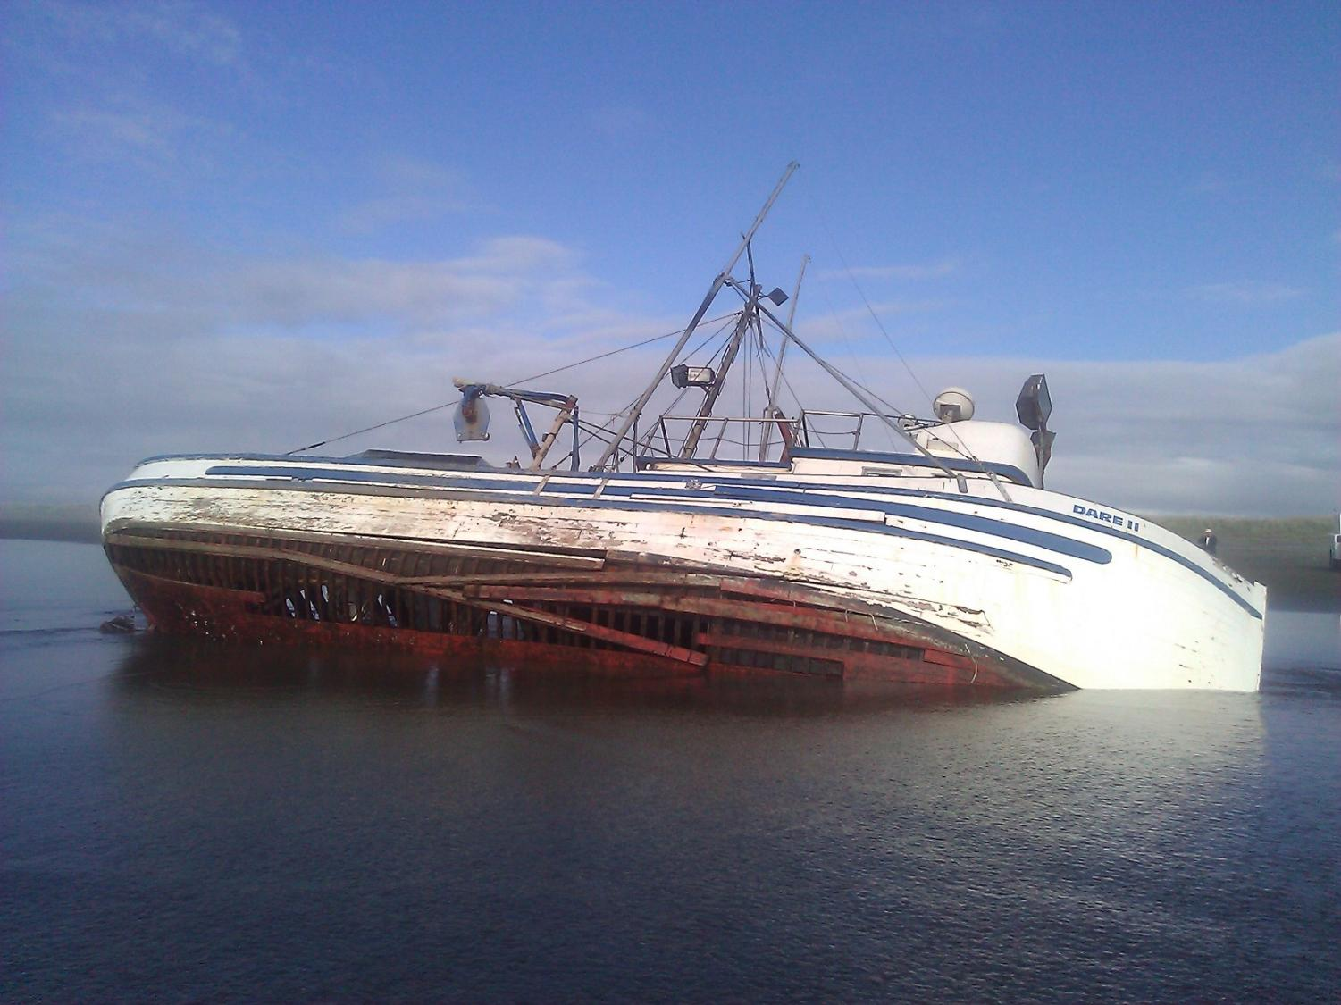
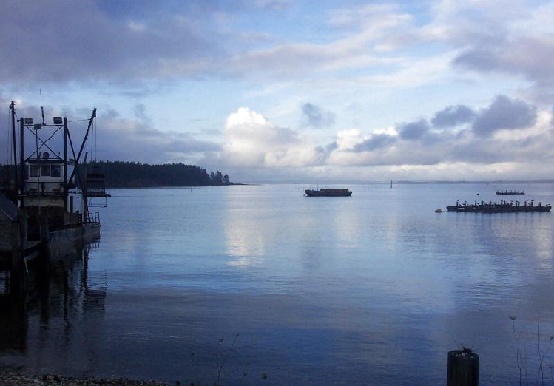
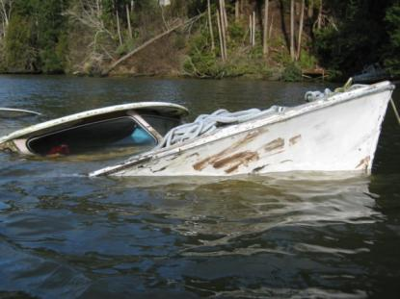
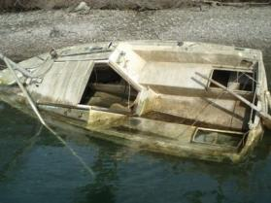

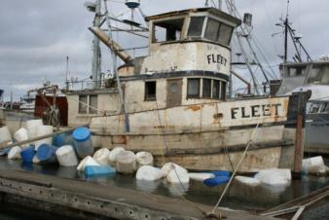
Washington’s DERELICT VESSEL
REMOVAL PROGRAM
November 2011

Slide 2
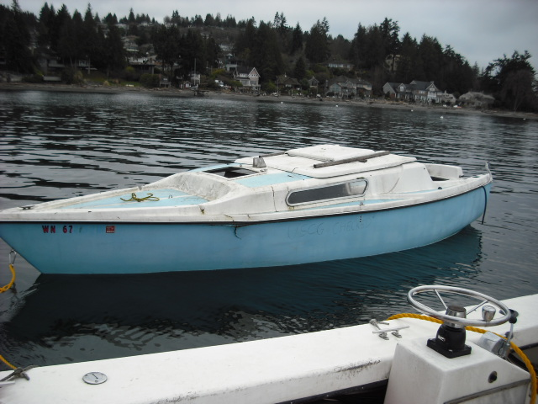
Goal: To reduce the number of derelict and abandoned vessels in the waters of the state.
Success: 374 Vessel removals completed by 49 Agencies since Jan. 2003

Slide 3
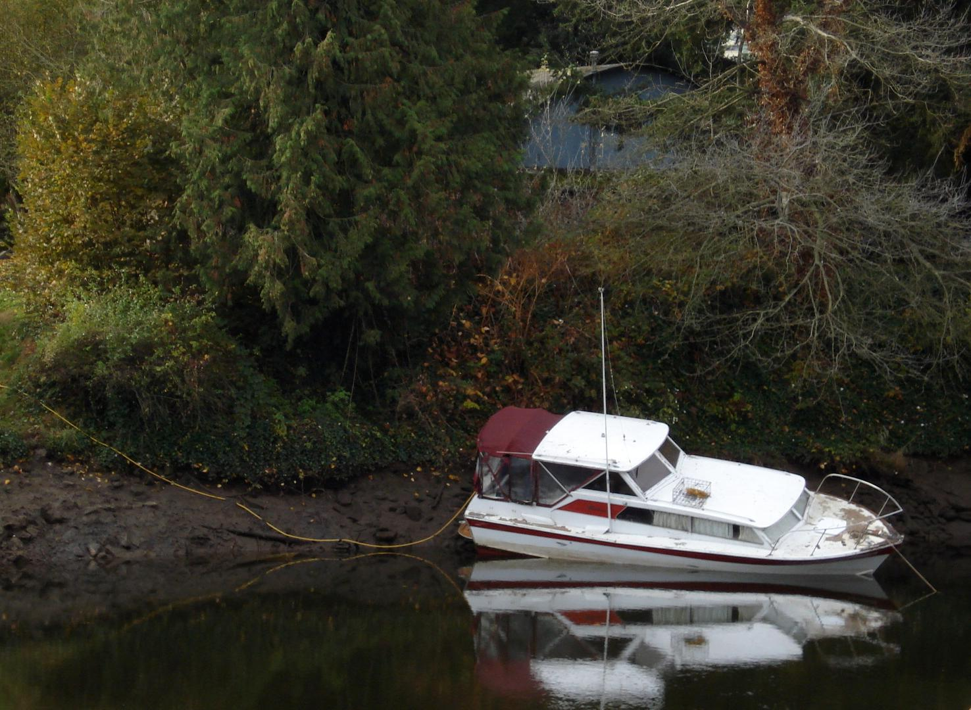
Program Elements
Authority for removal and disposal of derelict and abandoned vessels up to 200’ in length
Derelict Vessel Removal Account: funding to reimburse agencies for 90% of vessel removal and disposal costs. The remaining 10% may be funds or “in-kind” services (personnel time, etc).

Slide 4
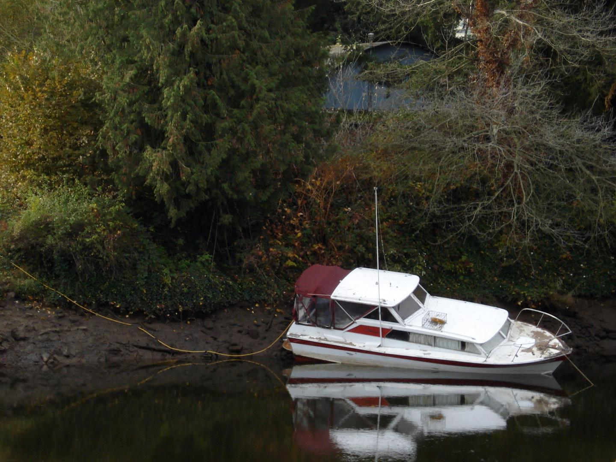
Program Elements
Derelict Vessel Inventory: A database for all derelict/abandoned vessels reported since the Program began. Each vessel is listed by priority category, which establishes the removal order for DNR.
Guidance and assistance to public entities and the public.

Slide 5
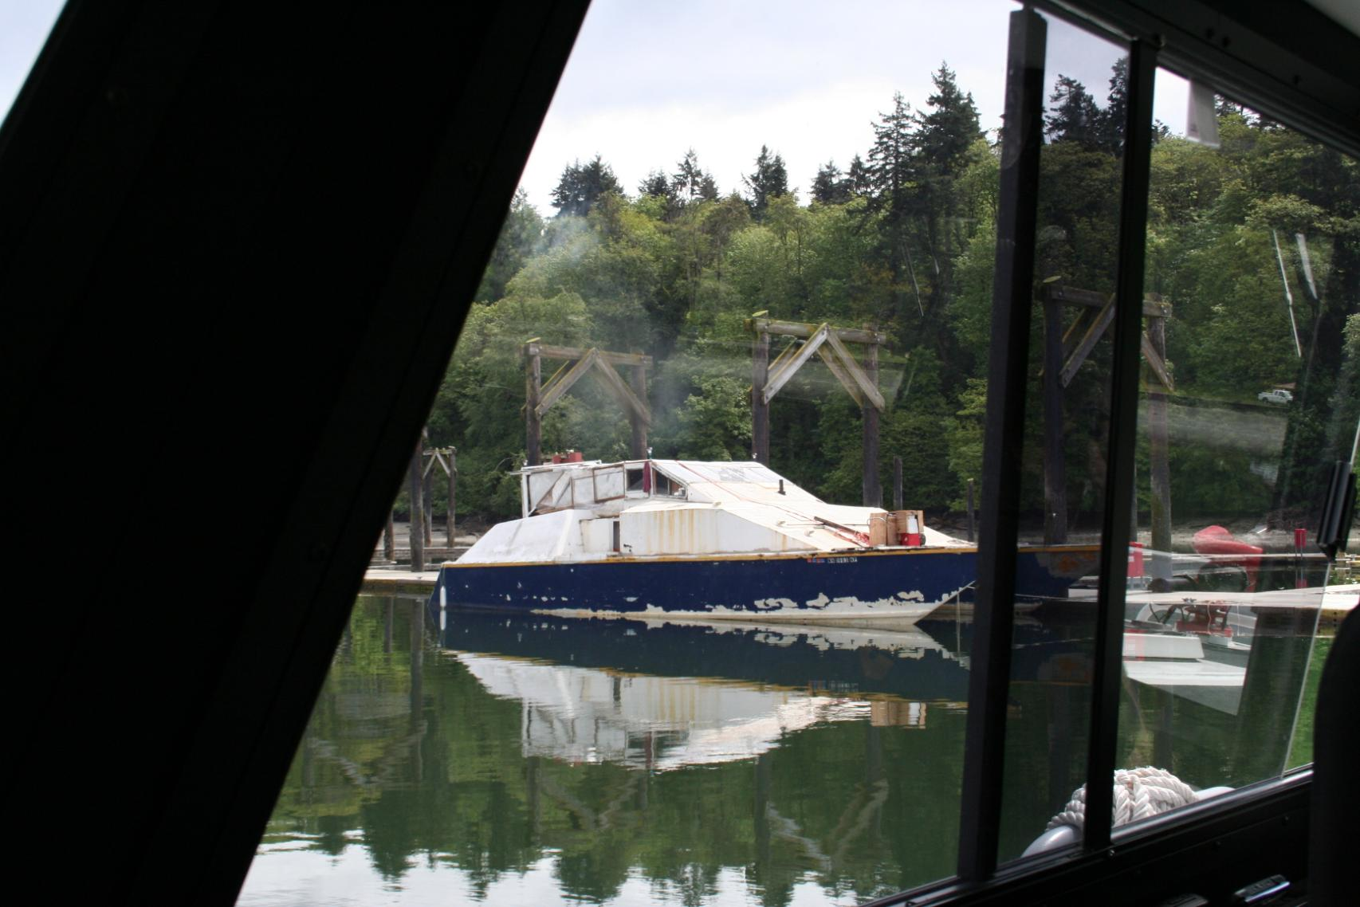
Prevention
Registration:
www.dol.wa.gov

Slide 6
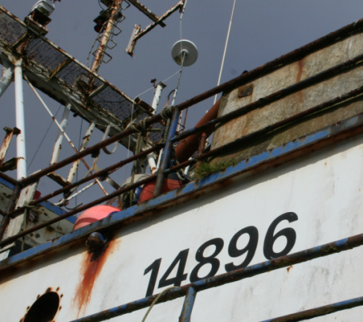
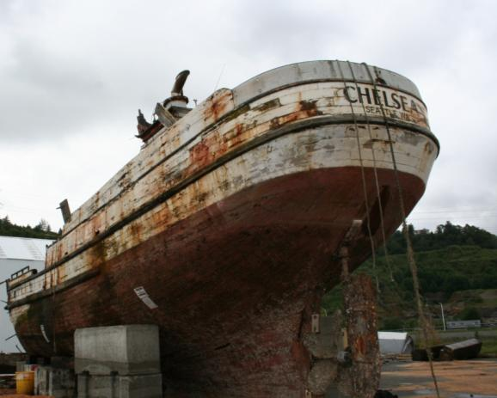
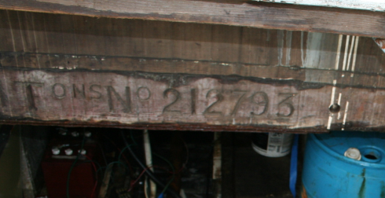
Title & Registration Commercial Vessels
Titled/documented with the US Coast Guard and pay property tax to the Dept of Revenue.
Vessel Name & Port of Call on stern and name on sides of bow. Displays 5-6 digit document number. Should have a DOR sticker in the window.

Slide 7
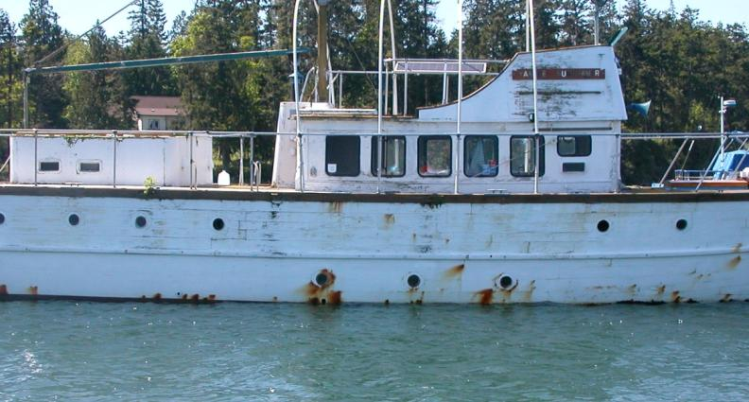
Title & Registration
Large Recreational Vessels
Recreational vessels over 5 tons may be titled/documented with the US Coast Guard or titled with the state, at owner’s option.
Vessel Name & Port of Call on stern. Will have a 5-6 digit document number but usually just on the inside. Registration Sticker but not WN number displayed.

Slide 8
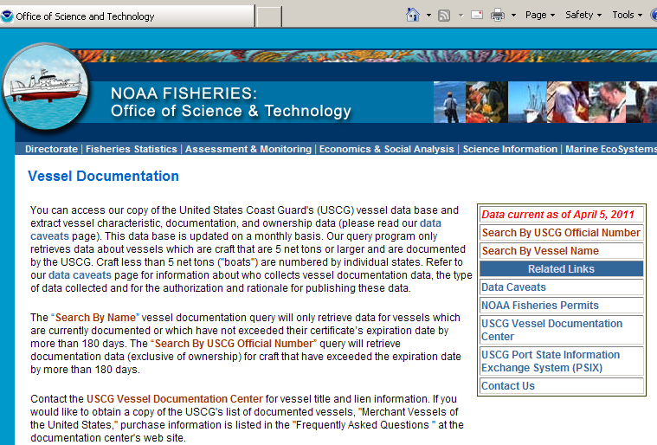
Title & Registration
http://www.st.nmfs.noaa.gov/st1/CoastGuard/index.html

Slide 9
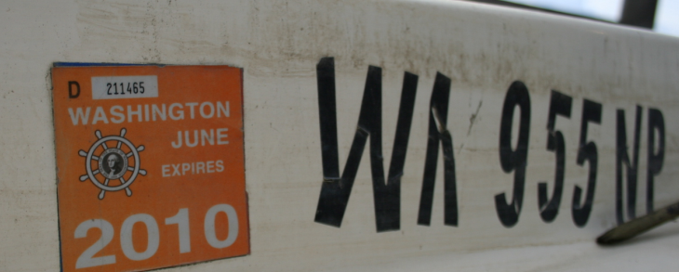
Title & Registration for Recreational Vessels
Recreational vessels over 16’ long are required to be registered with the DOL and display a current registration sticker. They have a WN number displayed on the bow.

Slide 10
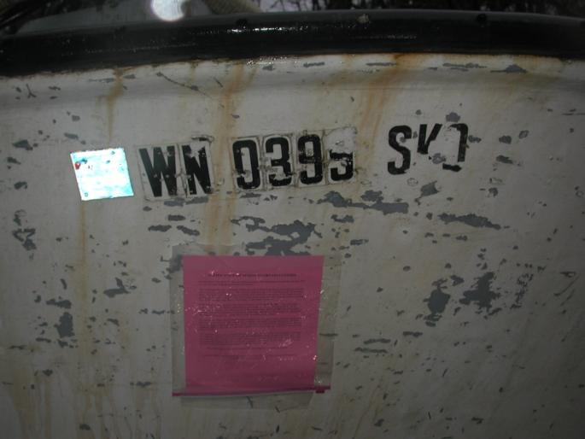
Title & Registration for Tribal Members
Vessels belonging to Tribal Members are often registered with their Tribe
WN number ending in three letters. Display a Washington Registration Sticker

Slide 11
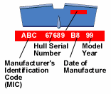
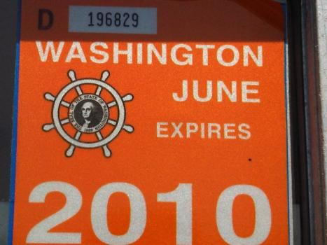
Tips for Investigating
Record the WN #, the year the vessel was last registered, and the vessel registration decal number (including any pre-imprinted letters). The decal number can be used to look up the vessel if you have the year of the registration sticker.
Look for a hull ID number

Slide 12
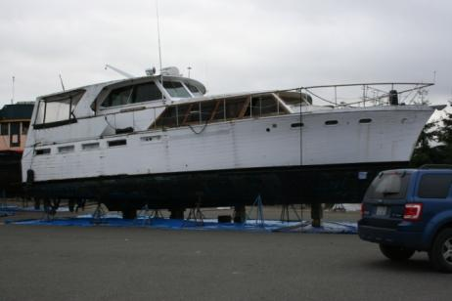
Finding the Owner
Department of Licensing Records
File a police report for abandonment under RCW 79.100.110
US Coast Guard
  National Vessel Documentation Center
Online Search Engines
  www.pipl.com
  www.spokeo.com
  Washington Courts
  Dept of Corrections “Find an Offender”

Slide 13
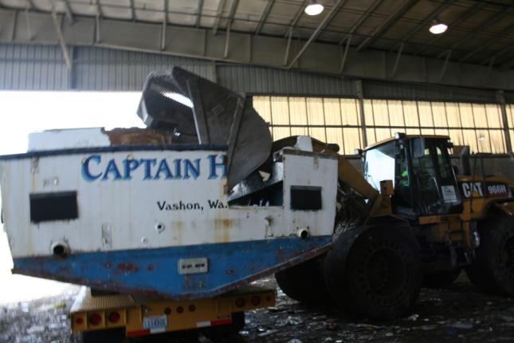
Disposing of the Boat
Authorities for Disposal:
Abandoned Vessels WAC 308-93-275
  Private Moorage Facilities
    RCW 88.26
  Port Moorage Facilities
    RCW 53.08
  Derelict Vessel Act
    RCW 79.100
  Lost & Found Property Laws
  Abandoned Property Laws
Methods of Disposal:
Auction
Direct Haul to Landfill
Boatyard/Shipyard Demolition

Slide 14
Derelict Vessel Removal Program
Aquatic Resources Division
1111 Washington St SE, MS 47027
Olympia, WA 98504-7027
Melissa Ferris (360) 902-1574
Steve Fraidenburg (360) 902-1548
DVRP@dnr.wa.gov
http://www.dnr.wa.gov

Slide 15
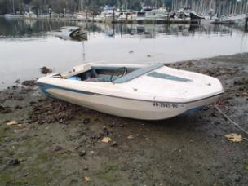
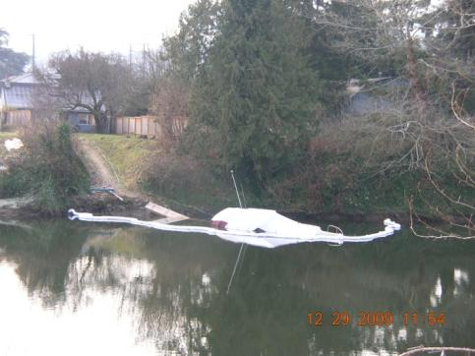
Program Priorities
Vessels in danger of
  sinking,
  breaking up,
  blocking navigation, or
  presenting an imminent threat to human health or the environment (RCW 79.100.100(3))
DNR-lead vessel removals are in order of priority
Other agencies don’t have to follow the same removal order

Slide 16
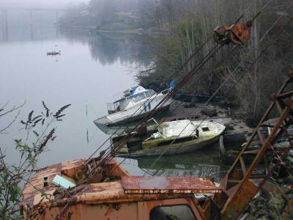
Steps for Taking Custody
Report vessel to DNR
Obtain custody of the vessel by (RCW 79.100.040)
  Sending the owner a letter
  Posting a notice on the boat (30 days)
  Posting a notice on the DVRP Website
  Putting a notice in the newspaper
Owner has an appeal period (10 or 30 days)
Use or Dispose of the vessel appropriately
Attempt Cost Recovery from owner
Submit a Request for Reimbursement to DNR

Slide 17
Do Agencies have to?
No. RCW 79.100 is permissive not mandatory—it is intended as a tool, not a burden
Why Remove Derelict Vessels?
Improve water quality (reduce amount of antifouling paint, oil, fuel and other hazardous materials that could foul the environment).
Improve aesthetics
Reduce hazards to responsible boaters

Slide 18
Other Laws & Options
Ticket unlicensed vessels or report them to the Dept. of Revenue (or DNR) if you can’t find enough information to ticket (i.e. no identification on vessel).
File a “seller’s report” with the Dept. of Licensing to keep ownership information current when selling a vessel.

Slide 19
Other Laws & Options
Anchorage WAC 332-52-155. Person may not anchor their vessel for more than 30 days or more than 90 days out of 365 in the same 5 mile area without permission from property owner.
Criminal misdemeanor to cause a vessel to become abandoned or derelict RCW 79.100.110
Report to Dept of Ecology or US Coast Guard if vessel is spilling fuel

Slide 20
Enforcement Example: Bainbridge Island
2007 press release & e-mail to listserve: notice of increased vessel registration enforcement
242 boats inventoried at anchor, buoy or private docks (2008 inventory also included private marinas)
Mailed letters to owners with missing or expired tabs. Posted notices on vessels with no owner address on record. Courtesy calls to owners with current registration that hadn’t put the tabs on their boat.
74% initial compliance with registration laws (some bays 50%)
92% final compliance; 12 citations issued; 7 boats with unreachable owners identified as possibly abandoned

Slide 21
Hull Material of Boats Removed

Slide 22
Boats to be removed, by length
(as of Jan. 1, 2009)

Slide 23
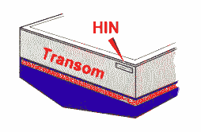
Hull Identification Number
All vessels built after 1972 must have a complete Hull Identification Number before the registration application can be processed. The HIN consists of 12 continuous characters at least one-quarter of an inch in height, uninterrupted by spaces, slashes, hyphens or other symbols. The HIN will be carved, burned, stamped, embossed, molded, bonded, or otherwise permanently affixed to the vessel.
The HIN on vessels with transoms must be affixed to the starboard (right) side of the transom within two inches of the top of transom, gunwale, or hull/deck joint, whichever is lowest.
On vessels without transoms, or impractical to use transoms, the HIN must be affixed to the starboard (right) outboard side of hull, aft, within one foot of the stern and within two inches of the top of the hull side, gunwale or hull/deck joint, whichever is lowest.
On catamarans and pontoon boats with replaceable hulls, the HIN must be affixed to the aft crossbeam, within one foot of the starboard (right) hull attachment.
Vessels that are 1972 and older are EXEMPT, they will not have an HIN.

